Slide 1
Teaching Java using Turtles part 1
Barb Ericson
Georgia Institute of Technology
May 2006

Slide 2
Learning Goals
To introduce computation as simulation
To introduce the turtle and talk about the history of using turtles to teach programming
To show how to add classes to the classpath in DrJava
To create objects in Java

Slide 3

Computers as Simulators
“The computer is the Proteus of machines. Its essence is its universality, its power to simulate. Because it can take on a thousand forms and serve a thousand functions, it can appeal to a thousand tastes.” Seymour Papert in Mindstorms

Slide 4
Creating a Simulation
Computers let us simulate things
  We do this by creating models of the things we want to simulate
  We need to define what types of objects we will want in our simulation and what they can do
    Classes define the types and create objects of that type
    Objects act in the simulation

Slide 5
Running a Simulation
How many objects does it take to get a person fed at a restaurant?
  Pick people to be the customer, greeter/seater, waiter, chef, and cashier and have them role play
    What data does each of these people need to do their job?
    What do they need to know how to do?
    What other objects do you talk about?
How about simulating going to a dentist?
  Or to the movies?

Slide 6
We will work with Turtle Objects
We have to define what we mean by a Turtle to the computer
  We do this by writing a Turtle class definition
    Turtle.java
  We compile it to convert it into something the computer can understand
    Bytes codes for a virtual machine
    Turtle.class

Slide 7
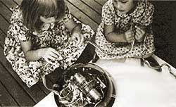
History of Turtles
Seymour Papert at MIT in the 60s
  By teaching the computer to do something the kids are thinking about thinking
    Develop problem solving skills
    Learn by constructing and debugging something
      Learn by making mistakes and fixing them
Notes:
Seymour was also involved in the invention of the Logo programming languages.

Slide 8
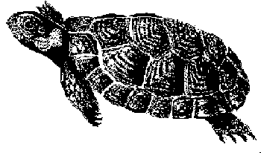
Using Turtles
The Turtle Class was is part of several classes created at Georgia Tech
  As part of a undergraduate class
Add bookClasses to your classpath to use these classes
Notes:
This set of turtle clip art was created by Robert Savannah, an artist working for the U. S. Fish and Wildlife Service. You can find it at http://greennature.com/article1775.html.

Slide 9
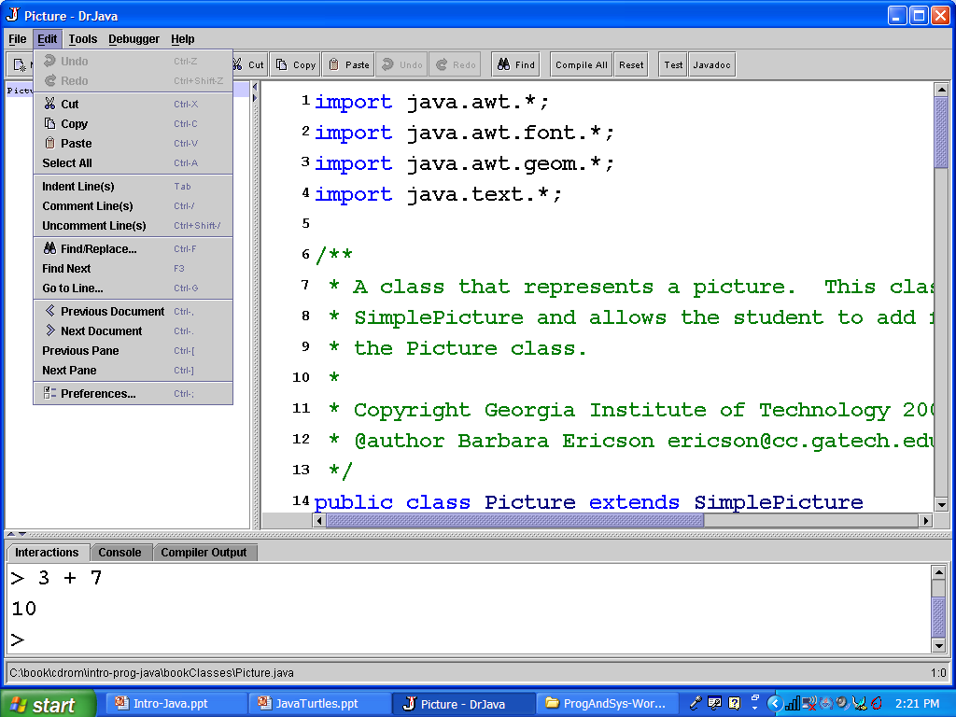
Open Preferences in DrJava
Notes:
Open the preferences window to add the book classes to the classpath. The classpath tells Java where to look for
classes.

Slide 10
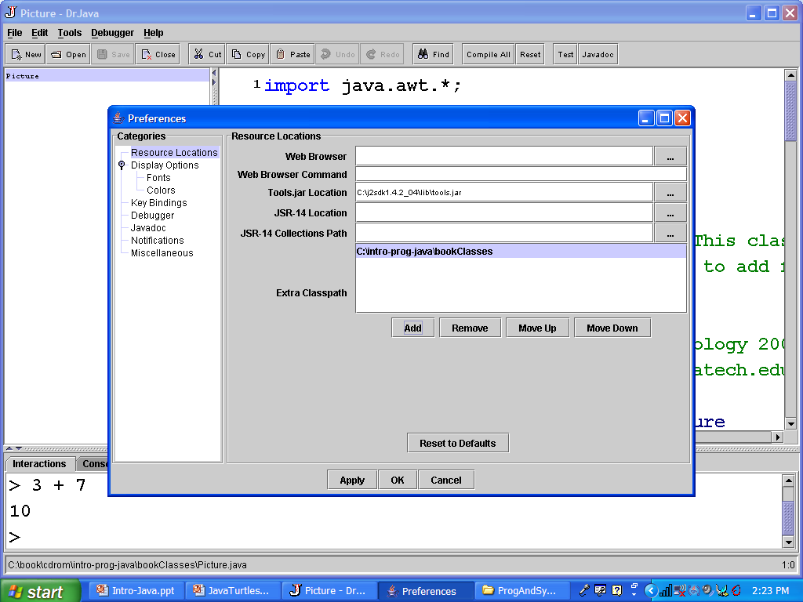
Adding Book Classes to Classpath
Add bookClasses
directory
Click on Add
Notes:
Be sure to add the bookClasses directory and not bookClasses\bookClasses.

Slide 11

Creating Objects
To create objects we ask the object that defines the class to create it
  Each object keeps a reference to the class that created it
The class is like a cookie cutter
  It knows how much space each object needs (shape)
  Many objects can be created from the class
World
Object 1
World
Object 2
World: Class

Slide 12
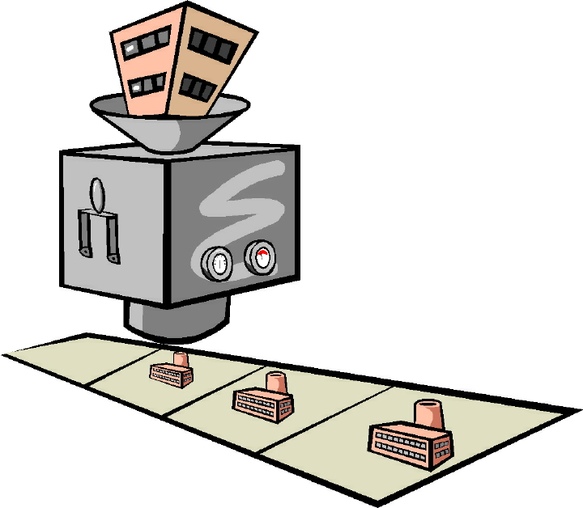
Class as Object Factory
A class is like a factory that creates objects of that class
We ask a class to create an object by using the keyword: new ClassName
We can also ask the class to initialize the object
  And pass data to help initialize it

Slide 13
Creating Objects in Java
In Java to create an object of a class you use
  new Class(value, value, …);
Our Turtle objects live in a World object
  We must create a World object first
  Try typing the following in the interactions pane:
  new World();

Slide 14
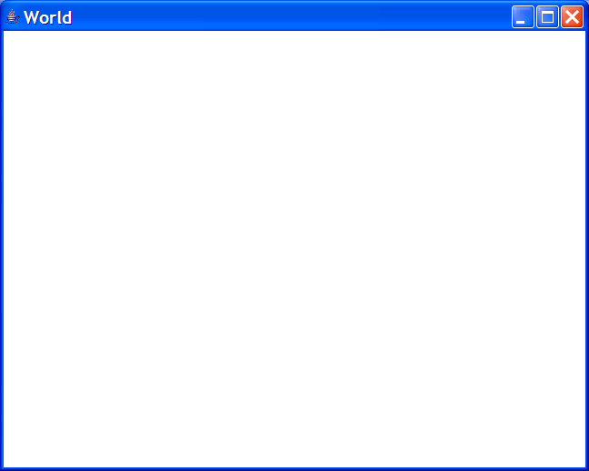
Creating Objects
If you just do
  new World();
You will create a new World object and it will display
  But you will not have any way to refer to it again
  Once you close the window the object can be garbage collected
    The memory can be reused
We need a way to refer to the new object
  to be able to work with it again
Notes:
The object is created and is in computer memory but we don’t have a way to find where it is.

Slide 15
Naming is Important
If you get a new pet one of the first things you do is name it
  Gives you a way to refer to the new pet without saying
    Please take that dog we got yesterday for a walk.
    Please take Fifi for a walk.
In programming we name things we want to refer to again
  Gives us a way to work with them
  Like the World object
This is called declaring a variable

Slide 16
Summary
Computers are often used for simulations
Turtles have been used to teach
  logical thinking and geometry for decades
You can add classes to the classpath in DrJava
  Where to look for classes that aren’t part of the Java language
You can create objects of a class
  new Class(value1,value2)
    new World();
We declare variables to be able to refer to objects after they are created
  World earth = new World();
  Turtle t1 = new Turtle(earth);

